Slide 1

Introduction to Operating Systems CS/COE 1550
Spring 2020-2021
Sherif Khattab
ksm73@pitt.edu
(Some slides are from Silberschatz, Galvin and Gagne ©2013)

Slide 2
Announcements
Upcoming deadlines:
3/12: Project 2 and Homework 7
Tophat questions due one week after each lecture
Comment on each other’s muddiest points
Women in Data Science Conference
http://www.stat.cmu.edu/wids/

Slide 3
Last Lecture …
CPU Scheduling Algorithms
SJF
Priority
Round-robin
Multi-level Queueing

Slide 4
Muddiest Points (1/2)
multilevel scheduling with dynamic priorities
what are the disadvantages to using multilevel feedback scheduling
For multilevel feedback scheduling, each queue can have its own scheduling scheme. Is this scheme static, purely decided up by the OS architects, or can it be changed, such as by an interrupt or syscall?
With Multilevel Feedback Scheduling, does that include a scheduling scheme that would automatically place processes that have an inherently higher priority into a higher level Ready Queue, then place it into a new queue after each quantum along with all the other processes? Or is that something a bit different
Multilevel Feedback Scheduling... doesn't it lead to much longer times for long processes, since they keep getting pushed back in priority?
Why is starvation of long processes not a significant problem in Multilevel Feedback Scheduling?
What makes multilevel feedback scheduling better than shortest job first, aren’t they both io favored?
round robin algorithm tracing
Round robin scheduling and its ready queue
the quantum
Still rusty with how the time quantum is formatted within round robin scheduling
Is round-robin just FCFS with preemptive scheduling? Also I did not understand the Round-Robin critique.
How does having a time slice that is larger than the typical interaction penalize IO processes in Round Robin? Once the process interacts with an IO device wouldnt it block and be preempted?
Will it have lots of overhead while it has Round Rubin algorithm?

Slide 5
Round-Robin
Selection function: same as FCFS
Decision mode: pre-emptive
a process is allowed to run until the time slice period (quantum, typically from 10 to 100 ms) has expired
a clock interrupt occurs and the running process is put on the ready queue
Process
Arrival Time
Service Time
1
0
3
2
2
6
3
4
4
4
6
5
5
8
2

Slide 6

Round-Robin
Selection function: same as FCFS
Decision mode: pre-emptive
a process is allowed to run until the time slice period (quantum, typically from 10 to 100 ms) has expired
a clock interrupt occurs and the running process is put on the ready queue
Process
Arrival Time
Service Time
1
0
3
2
2
6
3
4
4
4
6
5
5
8
2

Slide 7

Round-Robin
Selection function: same as FCFS
Decision mode: pre-emptive
a process is allowed to run until the time slice period (quantum, typically from 10 to 100 ms) has expired
a clock interrupt occurs and the running process is put on the ready queue
Process
Arrival Time
Service Time
1
0
3
2
2
6
3
4
4
4
6
5
5
8
2

Slide 8

Round-Robin
Selection function: same as FCFS
Decision mode: pre-emptive
a process is allowed to run until the time slice period (quantum, typically from 10 to 100 ms) has expired
a clock interrupt occurs and the running process is put on the ready queue
Process
Arrival Time
Service Time
1
0
3
2
2
6
3
4
4
4
6
5
5
8
2

Slide 9


Round-Robin
Selection function: same as FCFS
Decision mode: pre-emptive
a process is allowed to run until the time slice period (quantum, typically from 10 to 100 ms) has expired
a clock interrupt occurs and the running process is put on the ready queue
Process
Arrival Time
Service Time
1
0
3
2
2
6
3
4
4
4
6
5
5
8
2

Slide 10

Round-Robin
Selection function: same as FCFS
Decision mode: pre-emptive
a process is allowed to run until the time slice period (quantum, typically from 10 to 100 ms) has expired
a clock interrupt occurs and the running process is put on the ready queue
Process
Arrival Time
Service Time
1
0
3
2
2
6
3
4
4
4
6
5
5
8
2

Slide 11

Round-Robin
Selection function: same as FCFS
Decision mode: pre-emptive
a process is allowed to run until the time slice period (quantum, typically from 10 to 100 ms) has expired
a clock interrupt occurs and the running process is put on the ready queue
Process
Arrival Time
Service Time
1
0
3
2
2
6
3
4
4
4
6
5
5
8
2

Slide 12

Round-Robin
Selection function: same as FCFS
Decision mode: pre-emptive
a process is allowed to run until the time slice period (quantum, typically from 10 to 100 ms) has expired
a clock interrupt occurs and the running process is put on the ready queue
Process
Arrival Time
Service Time
1
0
3
2
2
6
3
4
4
4
6
5
5
8
2

Slide 13


Round-Robin
Selection function: same as FCFS
Decision mode: pre-emptive
a process is allowed to run until the time slice period (quantum, typically from 10 to 100 ms) has expired
a clock interrupt occurs and the running process is put on the ready queue
Process
Arrival Time
Service Time
1
0
3
2
2
6
3
4
4
4
6
5
5
8
2

Slide 14

Round-Robin
Selection function: same as FCFS
Decision mode: pre-emptive
a process is allowed to run until the time slice period (quantum, typically from 10 to 100 ms) has expired
a clock interrupt occurs and the running process is put on the ready queue
Process
Arrival Time
Service Time
1
0
3
2
2
6
3
4
4
4
6
5
5
8
2

Slide 15


Round-Robin
Selection function: same as FCFS
Decision mode: pre-emptive
a process is allowed to run until the time slice period (quantum, typically from 10 to 100 ms) has expired
a clock interrupt occurs and the running process is put on the ready queue
Process
Arrival Time
Service Time
1
0
3
2
2
6
3
4
4
4
6
5
5
8
2

Slide 16


Round-Robin
Selection function: same as FCFS
Decision mode: pre-emptive
a process is allowed to run until the time slice period (quantum, typically from 10 to 100 ms) has expired
a clock interrupt occurs and the running process is put on the ready queue
Process
Arrival Time
Service Time
1
0
3
2
2
6
3
4
4
4
6
5
5
8
2

Slide 17

Round-Robin
Selection function: same as FCFS
Decision mode: pre-emptive
a process is allowed to run until the time slice period (quantum, typically from 10 to 100 ms) has expired
a clock interrupt occurs and the running process is put on the ready queue
Process
Arrival Time
Service Time
1
0
3
2
2
6
3
4
4
4
6
5
5
8
2

Slide 18

Round-Robin
Selection function: same as FCFS
Decision mode: pre-emptive
a process is allowed to run until the time slice period (quantum, typically from 10 to 100 ms) has expired
a clock interrupt occurs and the running process is put on the ready queue
Process
Arrival Time
Service Time
1
0
3
2
2
6
3
4
4
4
6
5
5
8
2

Slide 19


Round-Robin
Selection function: same as FCFS
Decision mode: pre-emptive
a process is allowed to run until the time slice period (quantum, typically from 10 to 100 ms) has expired
a clock interrupt occurs and the running process is put on the ready queue
Process
Arrival Time
Service Time
1
0
3
2
2
6
3
4
4
4
6
5
5
8
2

Slide 20

Round-Robin
Selection function: same as FCFS
Decision mode: pre-emptive
a process is allowed to run until the time slice period (quantum, typically from 10 to 100 ms) has expired
a clock interrupt occurs and the running process is put on the ready queue
Process
Arrival Time
Service Time
1
0
3
2
2
6
3
4
4
4
6
5
5
8
2

Slide 21

Round-Robin
Selection function: same as FCFS
Decision mode: pre-emptive
a process is allowed to run until the time slice period (quantum, typically from 10 to 100 ms) has expired
a clock interrupt occurs and the running process is put on the ready queue
Process
Arrival Time
Service Time
1
0
3
2
2
6
3
4
4
4
6
5
5
8
2

Slide 22


Round-Robin
Selection function: same as FCFS
Decision mode: pre-emptive
a process is allowed to run until the time slice period (quantum, typically from 10 to 100 ms) has expired
a clock interrupt occurs and the running process is put on the ready queue
Process
Arrival Time
Service Time
1
0
3
2
2
6
3
4
4
4
6
5
5
8
2

Slide 23

Round-Robin
Selection function: same as FCFS
Decision mode: pre-emptive
a process is allowed to run until the time slice period (quantum, typically from 10 to 100 ms) has expired
a clock interrupt occurs and the running process is put on the ready queue
Process
Arrival Time
Service Time
1
0
3
2
2
6
3
4
4
4
6
5
5
8
2

Slide 24
Muddiest Points (2/2)
Project 2
Setting up project 2. I keep getting deadlocks
cpu bounded process vs i/o bounded process
Understanding preemption
Still unsure about preemptive vs non-preemptive
How considerable is the overhead (typically) in SJF?
When to us ethe FCFS and when to use round robin
Still confused about turnaround time vs response time
How to estimate for CPU burst time in SJF
Which scheduling algorithms have the best waiting times, turnaround times, etc.

Slide 25
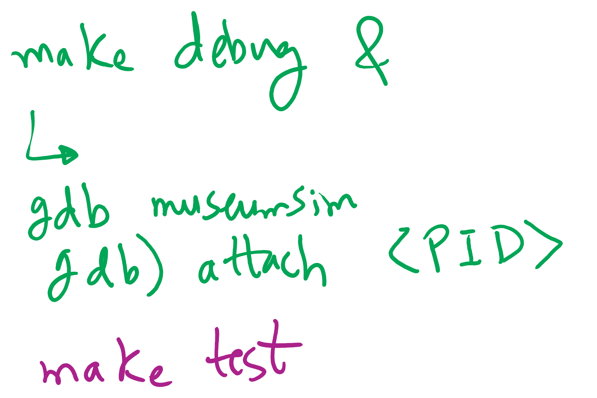
Project 2 hints

Slide 26
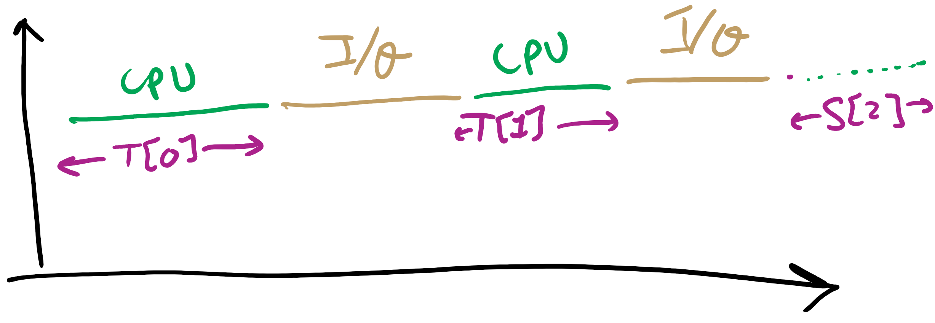
CPU-I/O Cycle

Slide 27
Today’s Agenda …
CPU Scheduling Algorithms
Multi-level Feedback
Estimating CPU burst time
Memory Management

Slide 28
Multilevel Feedback Scheduling
New process are placed in RQ₀
After the first quantum, they are moved to RQ₁, and to RQ₂ after the second quantum, … and to RQ_{N-1} after the Nth quantum
I/O-bound processes remain in higher priority queues.
CPU-bound jobs drift downward.
Hence, long jobs may starve

Slide 29
Multiple Feedback Queues
Different RQs may have different quantum values

Slide 30
Time Quantum for feedback Scheduling
With a fixed quantum time, the turn-around time of longer processes can be high
To alleviate this problem, the time quantum can be increased based on the depth of the queue
Time quantum of RQ_{i} = 2^{i-1}
May still cause longer processes to suffer starvation.
Possible fix is to promote a process to higher queue after some time
Process
Arrival Time
Service Time
1
0
3
2
2
6
3
4
4
4
6
5
5
8
2

Slide 31

Time Quantum for feedback Scheduling
With a fixed quantum time, the turn-around time of longer processes can be high
To alleviate this problem, the time quantum can be increased based on the depth of the queue
Time quantum of RQ_{i} = 2^{i-1}
May still cause longer processes to suffer starvation.
Possible fix is to promote a process to higher queue after some time
Process
Arrival Time
Service Time
1
0
3
2
2
6
3
4
4
4
6
5
5
8
2

Slide 32

Time Quantum for feedback Scheduling
With a fixed quantum time, the turn-around time of longer processes can be high
To alleviate this problem, the time quantum can be increased based on the depth of the queue
Time quantum of RQ_{i} = 2^{i-1}
May still cause longer processes to suffer starvation.
Possible fix is to promote a process to higher queue after some time
Process
Arrival Time
Service Time
1
0
3
2
2
6
3
4
4
4
6
5
5
8
2

Slide 33

Time Quantum for feedback Scheduling
With a fixed quantum time, the turn-around time of longer processes can be high
To alleviate this problem, the time quantum can be increased based on the depth of the queue
Time quantum of RQ_{i} = 2^{i-1}
May still cause longer processes to suffer starvation.
Possible fix is to promote a process to higher queue after some time
Process
Arrival Time
Service Time
1
0
3
2
2
6
3
4
4
4
6
5
5
8
2

Slide 34

Time Quantum for feedback Scheduling
With a fixed quantum time, the turn-around time of longer processes can be high
To alleviate this problem, the time quantum can be increased based on the depth of the queue
Time quantum of RQ_{i} = 2^{i-1}
May still cause longer processes to suffer starvation.
Possible fix is to promote a process to higher queue after some time
Process
Arrival Time
Service Time
1
0
3
2
2
6
3
4
4
4
6
5
5
8
2

Slide 35

Time Quantum for feedback Scheduling
With a fixed quantum time, the turn-around time of longer processes can be high
To alleviate this problem, the time quantum can be increased based on the depth of the queue
Time quantum of RQ_{i} = 2^{i-1}
May still cause longer processes to suffer starvation.
Possible fix is to promote a process to higher queue after some time
Process
Arrival Time
Service Time
1
0
3
2
2
6
3
4
4
4
6
5
5
8
2

Slide 36


Time Quantum for feedback Scheduling
With a fixed quantum time, the turn-around time of longer processes can be high
To alleviate this problem, the time quantum can be increased based on the depth of the queue
Time quantum of RQ_{i} = 2^{i-1}
May still cause longer processes to suffer starvation.
Possible fix is to promote a process to higher queue after some time
Process
Arrival Time
Service Time
1
0
3
2
2
6
3
4
4
4
6
5
5
8
2

Slide 37


Time Quantum for feedback Scheduling
With a fixed quantum time, the turn-around time of longer processes can be high
To alleviate this problem, the time quantum can be increased based on the depth of the queue
Time quantum of RQ_{i} = 2^{i-1}
May still cause longer processes to suffer starvation.
Possible fix is to promote a process to higher queue after some time
Process
Arrival Time
Service Time
1
0
3
2
2
6
3
4
4
4
6
5
5
8
2

Slide 38

Time Quantum for feedback Scheduling
With a fixed quantum time, the turn-around time of longer processes can be high
To alleviate this problem, the time quantum can be increased based on the depth of the queue
Time quantum of RQ_{i} = 2^{i-1}
May still cause longer processes to suffer starvation.
Possible fix is to promote a process to higher queue after some time
Process
Arrival Time
Service Time
1
0
3
2
2
6
3
4
4
4
6
5
5
8
2

Slide 39

Time Quantum for feedback Scheduling
With a fixed quantum time, the turn-around time of longer processes can be high
To alleviate this problem, the time quantum can be increased based on the depth of the queue
Time quantum of RQ_{i} = 2^{i-1}
May still cause longer processes to suffer starvation.
Possible fix is to promote a process to higher queue after some time
Process
Arrival Time
Service Time
1
0
3
2
2
6
3
4
4
4
6
5
5
8
2

Slide 40

Time Quantum for feedback Scheduling
With a fixed quantum time, the turn-around time of longer processes can be high
To alleviate this problem, the time quantum can be increased based on the depth of the queue
Time quantum of RQ_{i} = 2^{i-1}
May still cause longer processes to suffer starvation.
Possible fix is to promote a process to higher queue after some time
Process
Arrival Time
Service Time
1
0
3
2
2
6
3
4
4
4
6
5
5
8
2

Slide 41

Time Quantum for feedback Scheduling
With a fixed quantum time, the turn-around time of longer processes can be high
To alleviate this problem, the time quantum can be increased based on the depth of the queue
Time quantum of RQ_{i} = 2^{i-1}
May still cause longer processes to suffer starvation.
Possible fix is to promote a process to higher queue after some time
Process
Arrival Time
Service Time
1
0
3
2
2
6
3
4
4
4
6
5
5
8
2

Slide 42

Time Quantum for feedback Scheduling
With a fixed quantum time, the turn-around time of longer processes can be high
To alleviate this problem, the time quantum can be increased based on the depth of the queue
Time quantum of RQ_{i} = 2^{i-1}
May still cause longer processes to suffer starvation.
Possible fix is to promote a process to higher queue after some time
Process
Arrival Time
Service Time
1
0
3
2
2
6
3
4
4
4
6
5
5
8
2

Slide 43

Time Quantum for feedback Scheduling
With a fixed quantum time, the turn-around time of longer processes can be high
To alleviate this problem, the time quantum can be increased based on the depth of the queue
Time quantum of RQ_{i} = 2^{i-1}
May still cause longer processes to suffer starvation.
Possible fix is to promote a process to higher queue after some time
Process
Arrival Time
Service Time
1
0
3
2
2
6
3
4
4
4
6
5
5
8
2

Slide 44
Algorithm Comparison
Which one is the best?
The answer depends on many factors:
the system workload (extremely variable)
hardware support for the dispatcher
relative importance of performance criteria (response time, CPU utilization, throughput...)
The evaluation method used (each has its limitations...)

Slide 45
Back to SJF: CPU Burst Estimation
Let T[i] be the execution time for the ith instance of this process: the actual duration of the ith CPU burst of this process
Let S[i] be the predicted value for the ith CPU burst of this process. The simplest choice is:
S[n+1] =(1/n)(T[1]+…+T[n])=(1/n) Σ{i=1 to n} T[i]
This can be more efficiently calculated as:
S[n+1] = (1/n) T[n] + ((n-1)/n) S[n]
This estimate, however, results in equal weight for each instance

Slide 46
CPU Burst Estimation

Slide 47
Estimating the required CPU burst
Recent instances are more likely to better reflect future behavior
A common technique to factor the above observation into the estimate is to use exponential averaging :
S[n+1] = α T[n] + (1- α) S[n] ; 0 < α < 1

Slide 48
CPU burst Estimate (Exponential Average)
Recent instances have higher weights, whenever α > 1/n
Expanding the estimated value shows that the weights of past instances decrease exponentially
S[n+1] = α T[n] + (1- α) α T[n-1] + ... (1- α)^{i} α T[n-i] +
... + (1- α)^{n}S[1]
The predicted value of 1st instance, S[1], is usually set to 0 to give priority to new processes

Slide 49
Exponentially Decreasing Coefficients

Slide 50
Exponentially Decreasing Coefficients
S[1] = 0 to give high priority to new processes
Exponential averaging tracks changes in process behavior much faster than simple averaging

Slide 51
Memory management
Basic memory management
Swapping
Virtual memory
Page replacement algorithms
Modeling page replacement algorithms
Design issues for paging systems
Implementation issues
Segmentation

Slide 52
In an ideal world…
The ideal world has memory that is
Very large
Very fast
Non-volatile (doesn’t go away when power is turned off)
The real world has memory that is:
Very large
Very fast
Affordable!
Pick any two…
Memory management goal: make the real world look as much like the ideal world as possible

Slide 53
Memory hierarchy
What is the memory hierarchy?
Different levels of memory
Some are small & fast
Others are large & slow
What levels are usually included?
Cache: small amount of fast, expensive memory
L1 (level 1) cache: usually on the CPU chip
L2 & L3 cache: off-chip, made of SRAM
Main memory: medium-speed, medium price memory (DRAM)
Disk: many gigabytes of slow, cheap, non-volatile storage
Memory manager handles the memory hierarchy

Slide 54
Basic memory management
Components include
Operating system (perhaps with device drivers)
Single process
Goal: lay these out in memory
Memory protection may not be an issue (only one program)
Flexibility may still be useful (allow OS changes, etc.)
No swapping or paging
0xFFFF
0xFFFF
User program (RAM)
Operating system (ROM)
Device drivers (ROM)
User program (RAM)
User program (RAM)
Operating system (RAM)
Operating system (RAM)
0
0

Slide 55
Fixed partitions: multiple programs
Fixed memory partitions
Divide memory into fixed spaces
Assign a process to a space when it’s free
Mechanisms
Separate input queues for each partition
Single input queue: better ability to optimize CPU usage
Partition 4
900K
Partition 4
900K
Partition 3
700K
Partition 3
700K
Partition 2
600K
Partition 2
600K
Partition 1
500K
Partition 1
500K
100K
100K
OS
OS
0
0

Slide 56
How many programs is enough?
Several memory partitions (fixed or variable size)
Lots of processes wanting to use the CPU
Tradeoff
More processes utilize the CPU better
Fewer processes use less memory (cheaper!)
How many processes do we need to keep the CPU fully utilized?
This will help determine how much memory we need
Is this still relevant with memory costing $10/GB?

Slide 57
Modeling multiprogramming
More I/O wait means less processor utilization
At 20% I/O wait, 3–4 processes fully utilize CPU
At 80% I/O wait, even 10 processes aren’t enough
This means that the OS should have more processes if they’re I/O bound
More processes => memory management & protection more important!

Slide 58
Base and limit registers
Special CPU registers: base & limit
Access to the registers limited to kernel (privileged) mode
Registers contain
Base: start of the process’s memory partition
Limit: length of the process’s memory partition
Address generation
Physical address: location in actual memory
Logical address: location from the process’s point of view
Physical address = base + logical address
Logical address larger than limit => error
0xFFFF
0x2000
Limit
Process partition
Base
0x9000
OS
0
Logical address: 0x1204 Physical address: 0x1204+0x9000 = 0xa204

